Slide 1
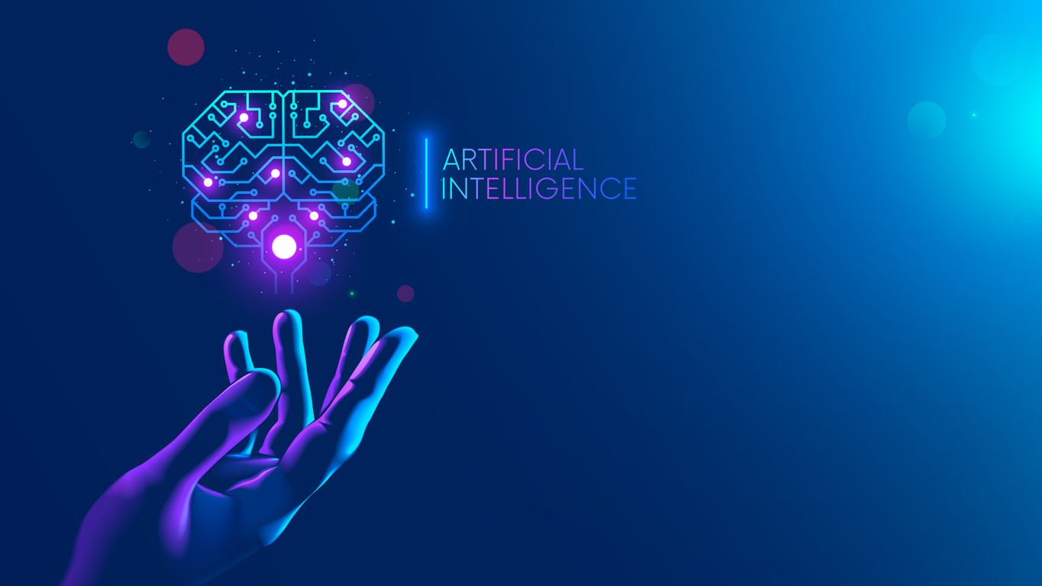
Presented by Amir Maharjan

Slide 2
Table of content
Definition
Advantages
Disadvantages

Slide 3
Artificial Intelligence
Artificial intelligence is intelligence demonstrated by machines, as opposed to the natural intelligence displayed by humans or animals. It is popularly known as AI(artificial intelligence) around the globe.

Slide 4
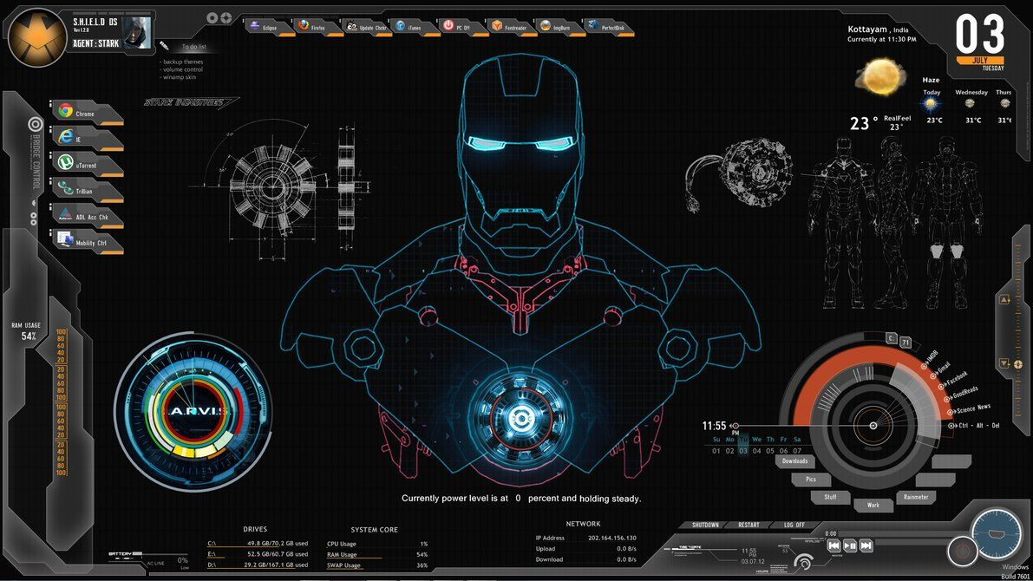
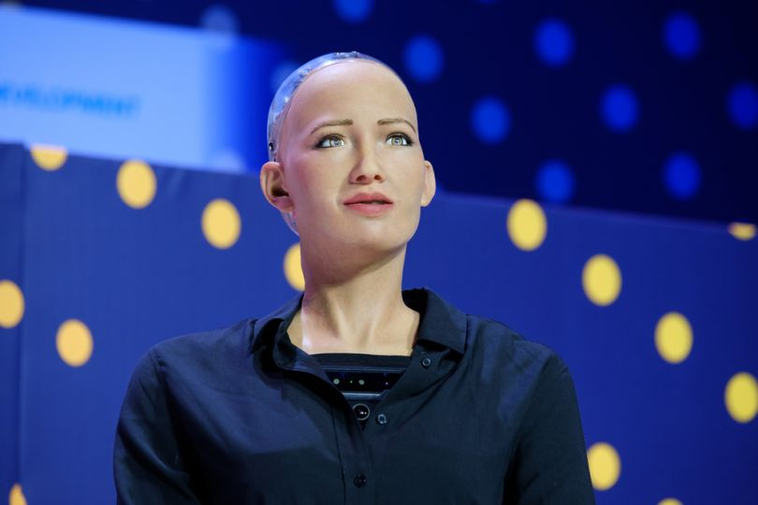
Examples

Slide 5
Advantages
Precision and Accuracy
Functions without stopping, Risk reducing
Can do laborious tasks
Used for mining tasks
Space exploration

Slide 6
Disadvantages
Costly for maintenance and repairing
Can be easily misused
Unemployment
Not able to act any different
Lack a creative mind

Slide 7
Thank you

